Slide 1


Michael Ames amesam@wfu.edu
Wake Forest
School of Business
_______
Explainable AI

Slide 2
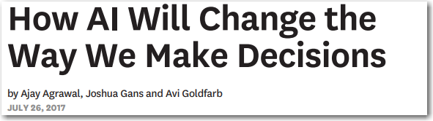
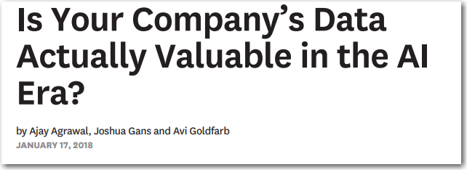
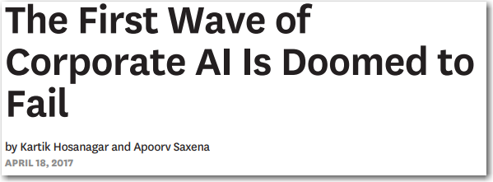
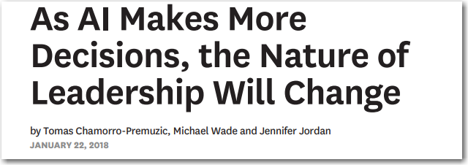
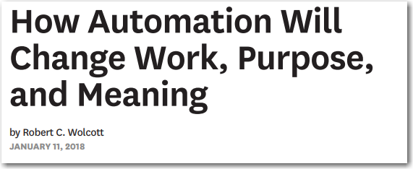
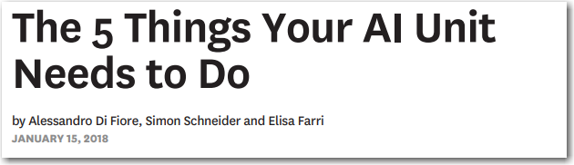
Notes:
Here is a small sample of the 30+ articles from Harvard Business Review on AI and machine learning … on one side AI spells doom and gloom, the other it promises everything from self-driving cars and medical breakthroughs…
A lot has been made of a computer beating the worlds best players at Go and Chess. Does anyone here play Go? Its complexity is masked in its simplicity.
But how do you separate hype from reality? How can your company apply AI and Machine Learning to solve real business problems in 2018?
I want to leave you with a few thoughts…
It’s the system that’s important
The juice is worth the squeeze
You can do this today
Peel back the lid on the Black-box

Slide 3
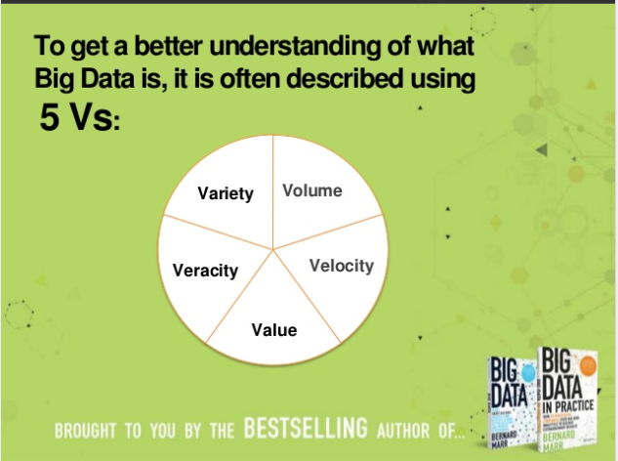
Who remembers…
3,4,or 5 V’s of Big Data?
Volume The vast amounts of data our systems pump out every second, it adds up.
Variety The different types of data we have access to, structured, unstructured, semi-structured, voice, text, image, video etc. it’s a lot.
Velocity The speed at which data is created.
Veracity The messiness or trustworthiness of data.
Value Which leads us to Analytics – how do we create value from data?
Notes:
We’ve all seen these trends come and go… 8 years ago it was big data and Hadoop today it’s AI – like any trend we have peel back the onion to see what's really going on….
the real story about Big Data hype parts in my opinion can be divided into two themes:
First business woke up the potential of leveraging their data with analytics, we saw explosive growth in the interest in Data Processing, and Business Intelligence and now we’ve seen that with advanced analytics, machine learning and AI
Second was the cost of storage and computing nose dived giving rise to Cloud computing … I mean i just bought a 2 TB $50 the other day…

Slide 4
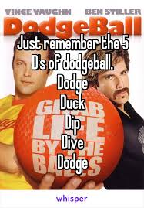
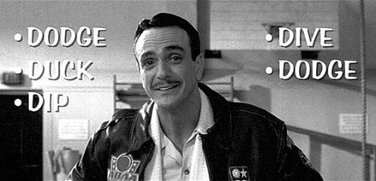
What about …
The 5 D’s of Dodgeball?
Dodge, Duck, Dip, Dive and Dodge
Notes:
So while I joke about the 3 V’s of big data – it was a great catch-phrase that we could latch onto, just like the 5 D’s of dodgeball. So I’ve come up with my own catch phrase….

Slide 5

Reality: Machine Learning is about building a SYSTEM
Automation
Automation is key to reducing the decision lag (the time between observation and action), maximizing system effectiveness.
Accuracy
Accuracy is a function of problem definition, data engineering, breadth of supervised and unsupervised algorithms & best practices.
Adaptability
Learning new and emerging patterns and threats within the data, minimizing detection lag, minimizing or eliminating model degradation overtime.
Accountability Consistency, interpretability, and governance of the system. AI systems should produce interpretable results and artifacts, digestible by both the business man and layman, it is the governance of automated systems more than just algorithmic accountability.
Notes:
The reality is machine learning is about building systems that can learn from data and improve over time.
Algorithms are important but it really is about building systems. When it comes to using Machine learning for fraud waste and abuse it’s the system that’s important – algorithm(s) used while important really are just part of the system. The system has to be developed in a way that it learns and adapts to changing trends, and the most advanced and effective systems be come core to the business.
I liken this to gold mining – you know you can start digging holes anywhere and hope to stumble upon gold – and we’ve seen popular TV shows that have sprung up that do just that. But the best gold miners
They prospect – test the ground to make sure there is gold there. Machine learning is no different the exploratory phase of ML does just that it prospects your data to find potential nuggets of information gold
They dig at scale – once they find profitable ground they optimize their system to push as much “pay-dirt” through their system, ML systems do the same thing. For credit card fraud do you want a system that decisions transactions 100% in real-time or just 50%?
They instrument – successful gold miners they have instrumented their business so they know how much fuel their trucks burn, how much dirt their plant can handle an hour, how much a down time etc. etc. – Machine Learning systems are no different we know how much fraud is found, how much time analyst investigate, we know the impact of prospecting on new and emerging threats – great systems are instrumented systems
Peter Drucker the founder the rational school of business management, author of 40 books had two famous quotes to live by "you can't manage what you can't measure.“, “If you can't measure it, you can't improve it”

Slide 6
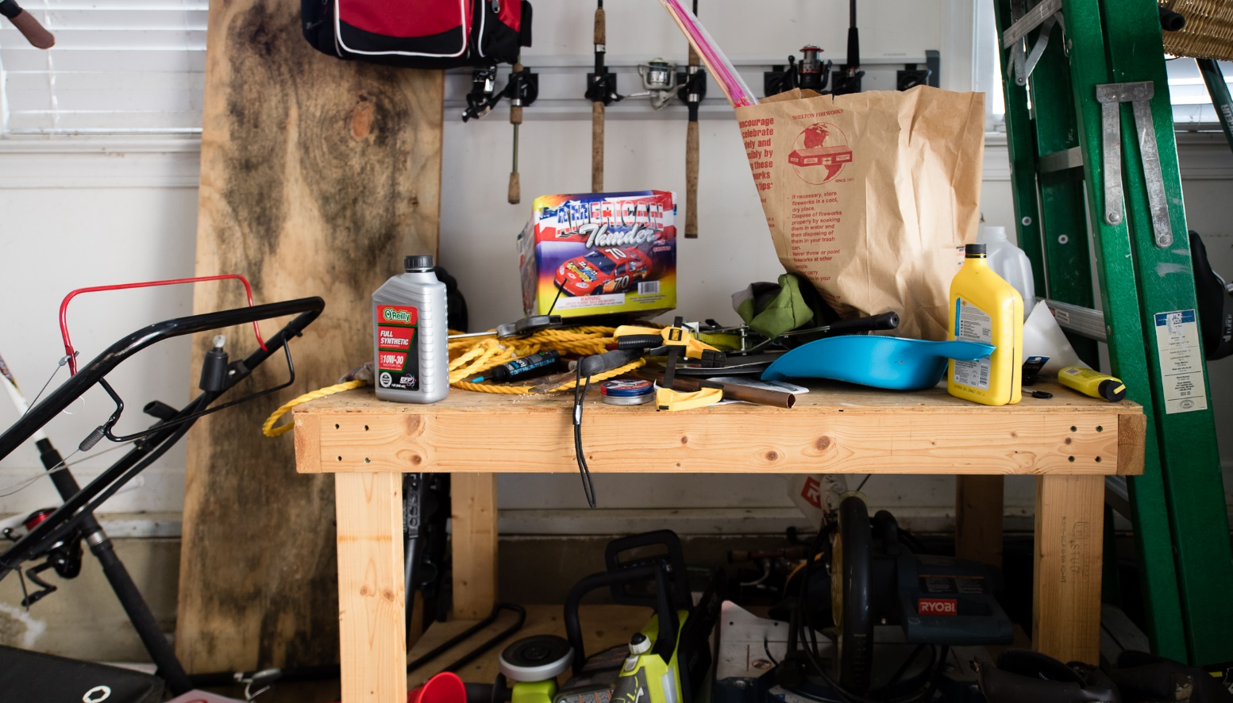
Real-world data science with disparate tools and techniques…
Notes:
There are two types of data science shops and the work-bench is the perfect metaphor for Data Science tools and technologies …
Some shops let the Data Scientists grab anything they want…. The workbench is small, it’s is built on a shaky foundation, this guy/gal has a few disparate tools and techniques. He invests when it’s convenient but also looks to buy the cheapest tool he can get away with… why this guy has a bag of fireworks, next to a couple of half empty cans of oil is another issue.
In the real world AI, ML, Data Science is like an addiction, we have to challenge our core beliefs that all it takes to be successful is the latest shiny thing from silicon valley. Take my workbench or garage for example, it’s a great metaphore for how we’ve allowed our AI, ML and Data Scientists to work. Just like my workbench, the workbench and tool sets that your data scientists are using, often are SMALL, cluttered with a bunch of disparate tools,
I often use the back of wrench for a hammer, I refuse to use nails I only use deck screws because that is what I was taught to do… I routinely use epoxy to hold things together but then regret it when I have to take things apart. It’s a dumping ground for stuff…. That is the reality for many of us…
we’ve left decisions up to the guy doing the work, rather than saying our construction standard is X…
AI is about building systems… and your workbench and tool kit will determine how well your system holds together…

Slide 7
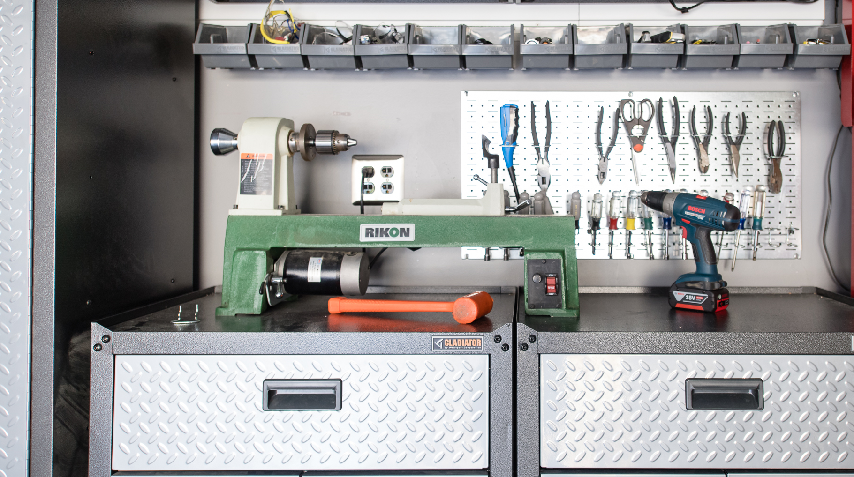
or another approach…
Notes:
Then you have the other guy, hopefully not the guy you are competing against. Lots of high quality tools built on a solid foundation that enables him to create things.
He’s invested in some high quality specialty tools, and knows how to use different screwdrivers, plyers and wrenches. Most importantly he’s organized and has CAPACITY.
Think about this, if you are competing on information and the tools and techniques at your disposal determine if you win or you loose, which workbench do you want?
You can either choose to have a small workbench with disparate tools that lacks the capacity to do anything of value, or your can have a large workbench with a proven set of tools giving your self capacity
You also have to think about your competitor, and their tools as we increasing compete on information the guy with the better system will win out..
, At the other end of the spectrum, are those companies who embrace technology but don’t leave it up to the individual to pick and choose the latest
My neighbor Joel by comparison, he has a big workbench and he only uses top of the line tools and has invested in some really nice machines like a band saw, a drill press and a table saw. Sure he spent a few bucks BUT he built the extension to his house, he’s built a boat, restored three cars and the list goes on and on…
What’s the difference the tools he’s chosen give him both the capacity and the productivity to do the work…

Slide 8
Explainable AI – What Are We Trying To Do?
Shed some light on the black box…
Dramatic success in machine learning has led to an explosion of AI applications.
Autonomous systems will perceive, learn, decide, and act on their own. However, the effectiveness of these systems will be limited by the machine’s inability to explain its thoughts and actions to human users.
Explainable AI is essential, if users are to understand, trust, and effectively manage this emerging generation technology.
• Why did you do that? • Why not something else? • When do you succeed? • When do you fail? • When can I trust you? • How do I correct an error?

Slide 9
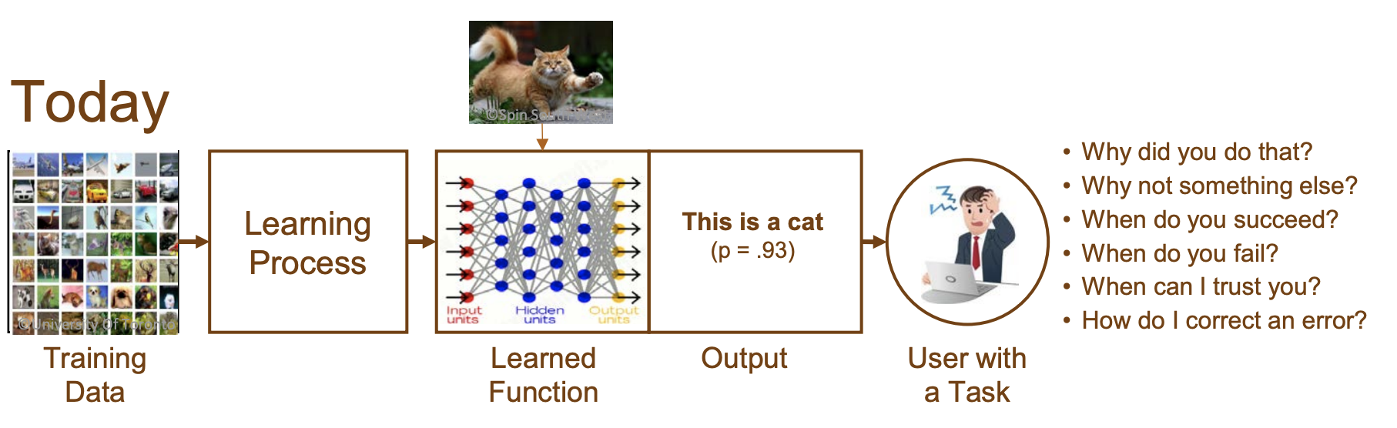
Explainable AI – What Are We Trying To Do?

Slide 10
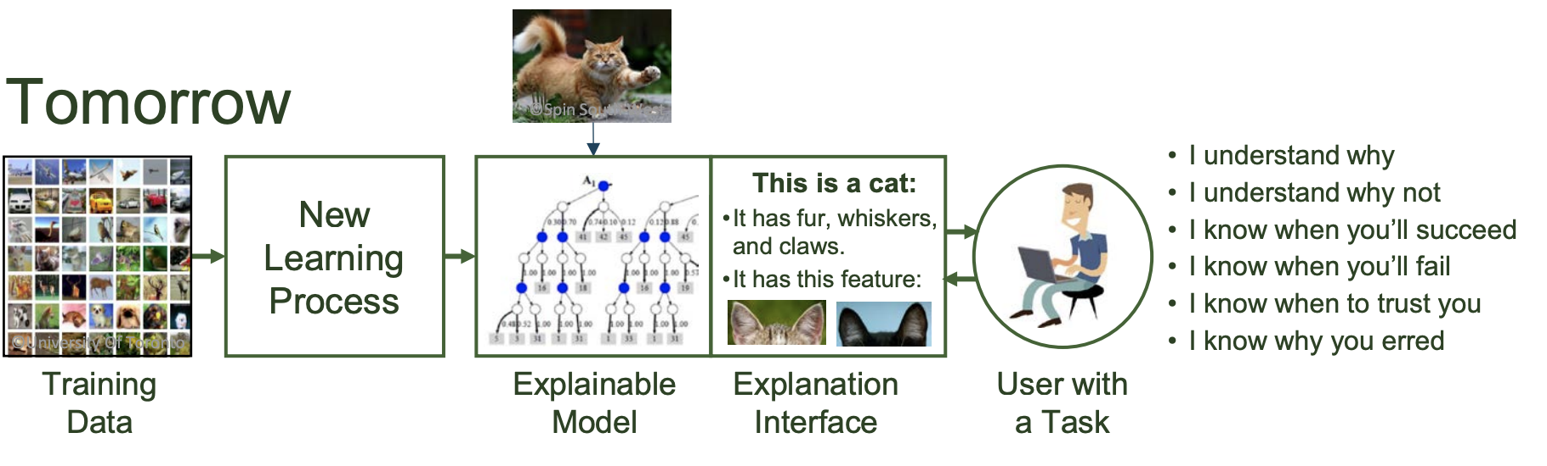
Explainable AI – What Are We Trying To Do?

Slide 11
Simple Approaches
Surrogate Model
Use a interpretable model (Decision Tree, Logistic, Generalized Additive Models GAMs)
Simply train on predicted score
LIME - Local Interpretable Model-Agnostic Explanations
LIME is an algorithm that can explain the predictions of any classifier in a faithful way, by approximating it locally with an interpretable model.
LOCO – Leave One Covariate Out
Simply predict by setting each covariate out and scaling the scores to sum to prediction.

Slide 12
Surrogate Model Approach
Train Blackbox classifier (RF, ET, GBM)
Make predictions .predict_proba on training set
Train a 2nd “white-box” model where the prediction probably is the target
You are trying to explain the prediction after all.
We’ll use a decision tree to keep it simple and extract rules
Create an interpretable artifact for each prediction
Business rules
IF THEN ELSE

Slide 13
Next week…
LOCO – for reason code building
One last method and encoder
Review Final Exam

Slide 14


